Slide 1
Data Types and Expressions
HIT137 Software Now
Week 02

Slide 2

We extend our respect to Elders - past, present and emerging - and to all First Nations people.

Slide 3


Outline
Understanding of:
Data Types
Variables and Assignment Statement
Lists and Tuple
Python Set
Control Flow Statement
Random Number generator

Slide 4
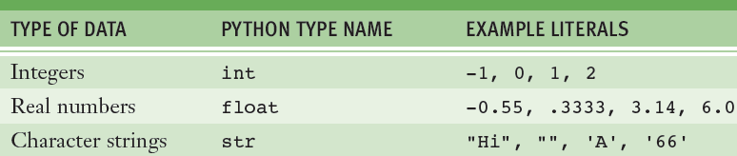
Data Types
A data type consists of a set of values and a set of operations that can be performed on those values.
E.g.
int and float are numeric data types
str is used for character data types

Slide 5
Integers
In real life, the range of integers is infinite!
A computer’s memory places a limit on magnitude of the largest positive and negative integers
Properties
Python’s int typical range: –2³¹ to 2³¹ – 1
Integer literals are written without commas
Basic operations such as +, -, *, /, etc
Built-in functions such as abs(x), pow(x, y), etc
Type conversion: int(3.14) → 3, int(‘41’) → 41

Slide 6
Floating-point Numbers
Python uses floating-point numbers to represent real numbers
Properties
Python’s float typical range: –10³⁰⁸ to 10³⁰⁸
Typical precision: 16 digits
Basic operations such as +, -, *, /, etc
Built-in Functions
round(x, n): Rounds x to n decimal places
abs(x): Absolute value of x
etc

Slide 7
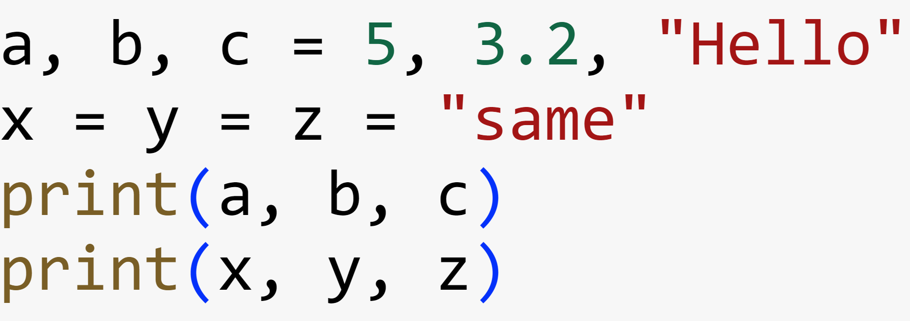
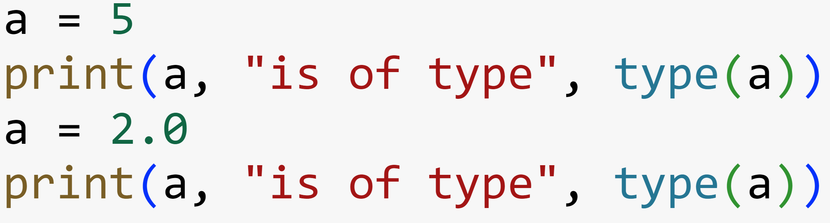
Variables and Types
A variable associates a name with a value
Makes it easy to remember and use later in program
Multiple assignments
Use type() function to know which class / data type the variable is:

Slide 8
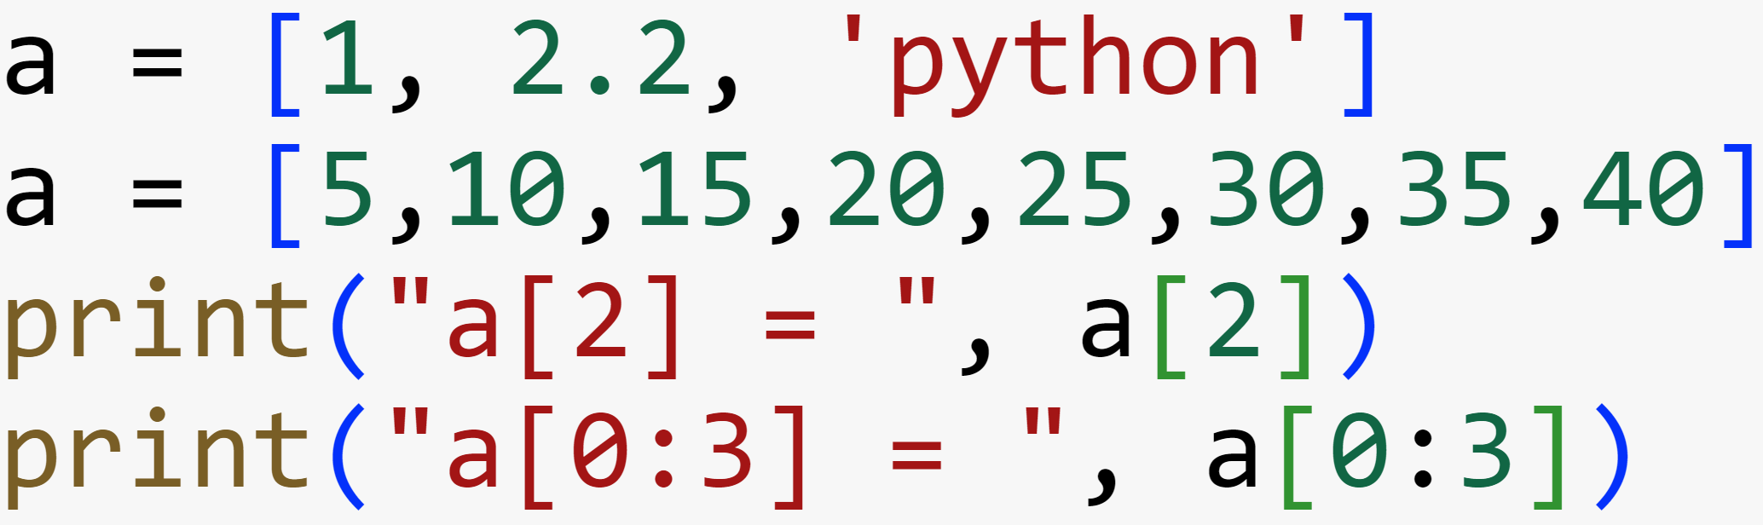
Lists and Tuple
List is an ordered sequence of items. It is one of the most used datatype in Python and is very flexible.
All the items in a list do not need to be of the same type.
Declaring a list is pretty straight forward. Items separated by commas are enclosed within brackets [ ].

Slide 9
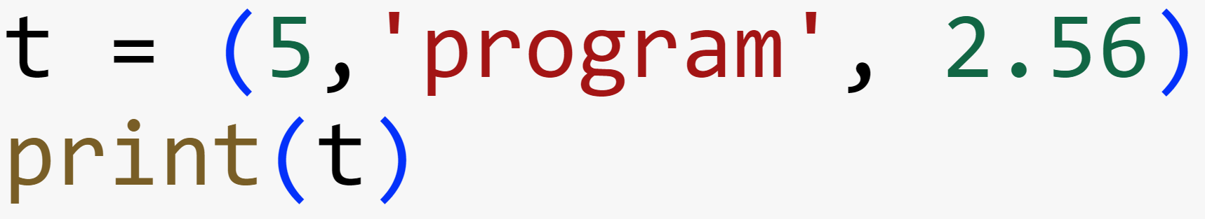
Tuple
Tuple is an ordered sequence of items same as list. The only difference is that tuples are immutable. Tuples once created cannot be modified.
Tuples are used to write-protect data and are usually faster than list as it cannot change dynamically.
It is defined within parentheses () where items are separated by commas.

Slide 10
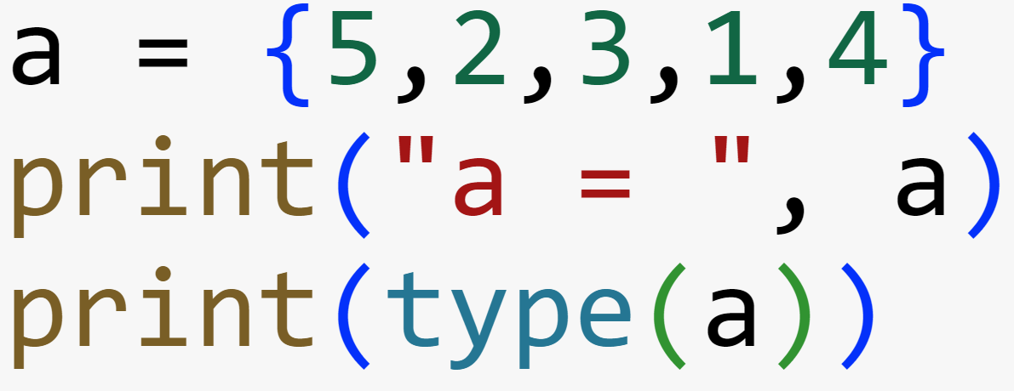
Python Set
Set is an unordered collection of unique items. Set is defined by values separated by comma inside braces { }. Items in a set are not ordered.
Note: Since, set are unordered collection, indexing has no meaning.
Dictionary is an unordered collection of key-value pairs.
It is generally used when we have a huge amount of data. Dictionaries are optimized for retrieving data. We must know the key to retrieve the value.

Slide 11
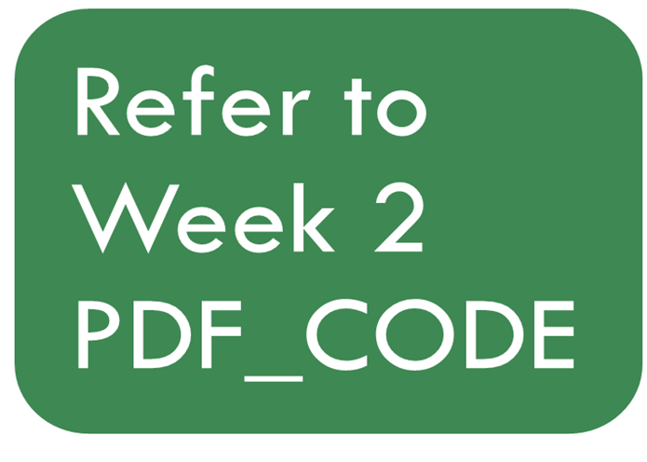
Practice

Slide 12
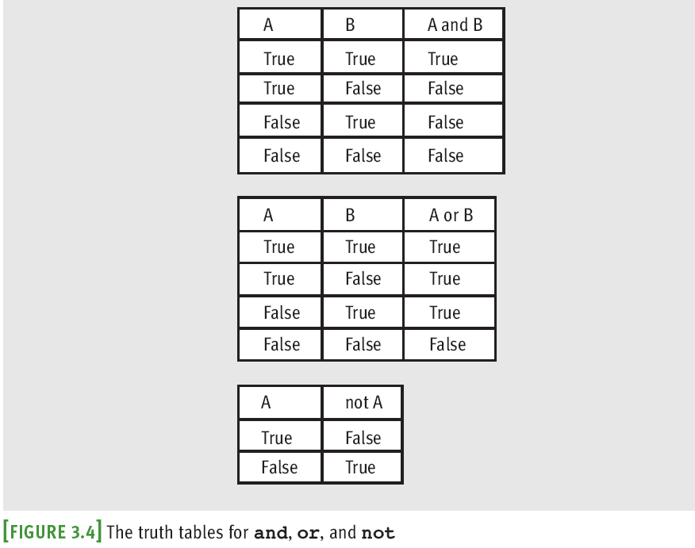
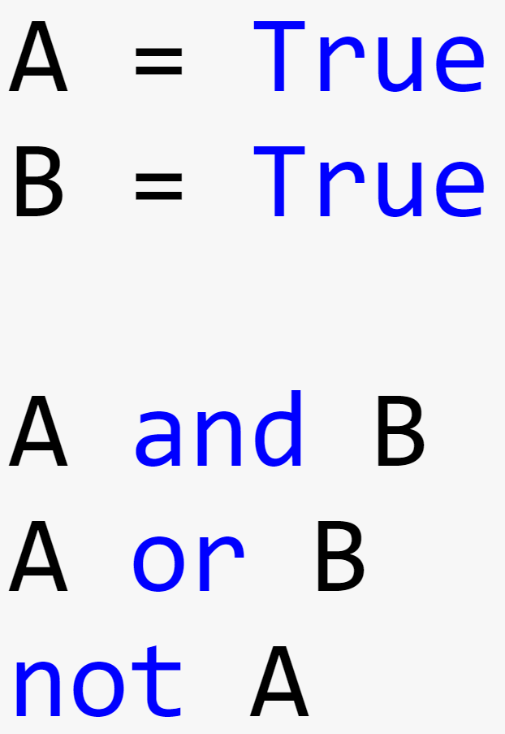
Logical Operators and Compound Boolean Expressions
Next example verifies some of the claims made in the previous truth tables:
The logical operators are evaluated after comparisons but before the assignment operator
not has higher precedence than and and or

Slide 13
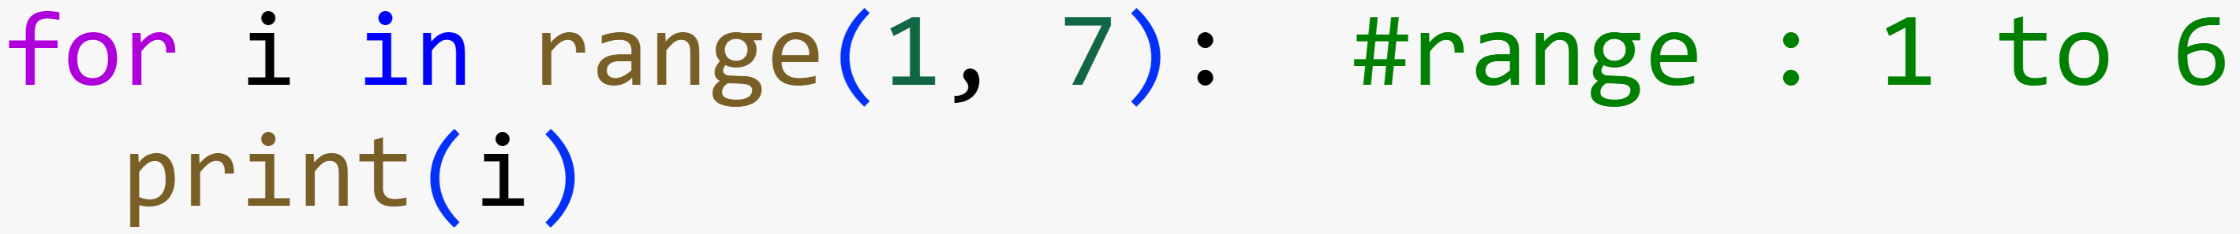
For Statement
Used for running a block of code repeatedly as long as the condition is true

Slide 14
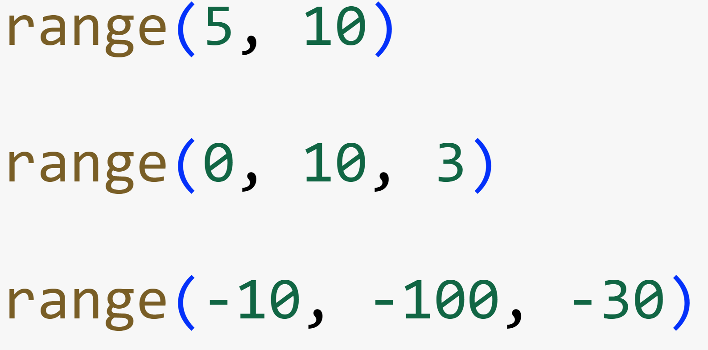
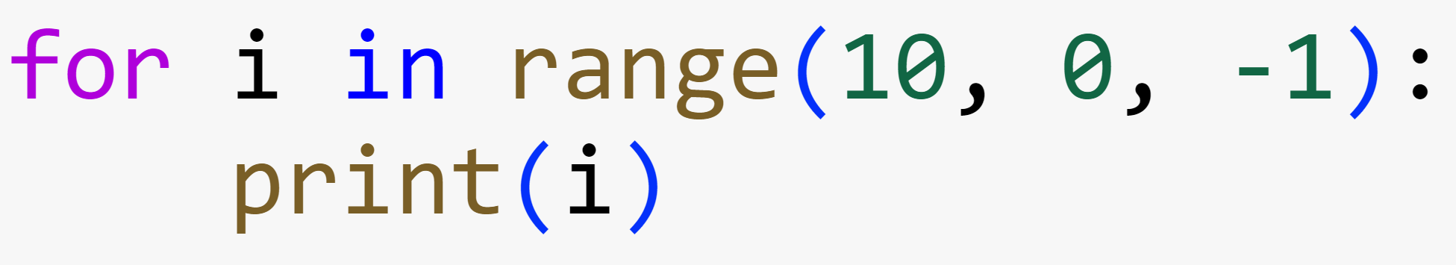
Examples on Using range function
Use for loop and range to print numbers starting from 10 to 1

Slide 15
Practice

Slide 16
Number Guess Problem
number = 23
guess = take a number from the user
Check if guess == number:
print('Congratulations, you guessed it.')
Else check if guess < number:
print('No, it is higher than that')
else:
print('No, it is lower than that')

Slide 17
While Statement
Used for running a block of code repeatedly as long as the condition is true

Slide 18
Random Numbers
Programming languages include resources for generating random numbers
random module supports several ways to do this
randint returns random number from among numbers between two arguments, included

Slide 19
Tutorial Session
Start Solving Tutorial Questions

Slide 20
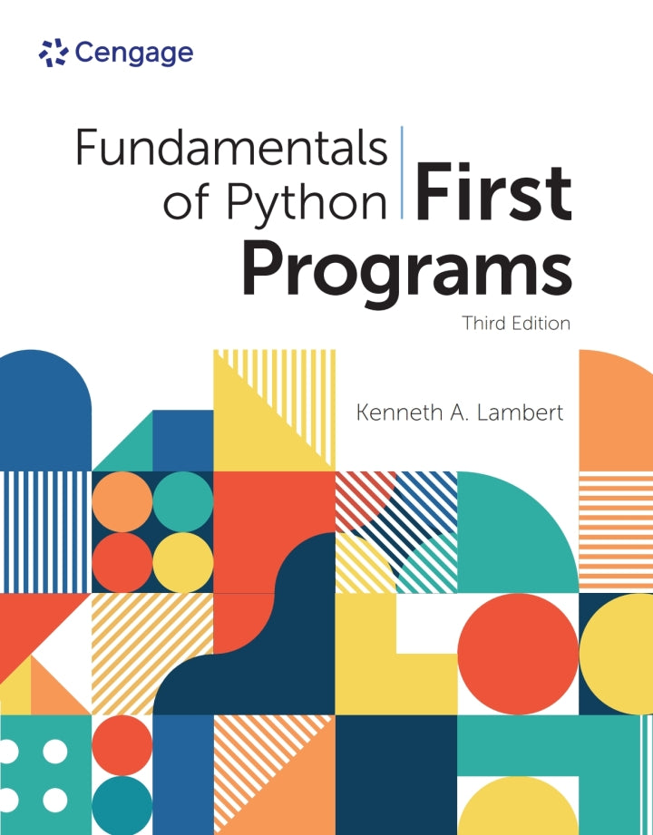
Resources
Some great resources to start your work :
Fundamentals of Python: First Programs
https://www.w3schools.com/python/default.asp
https://python.swaroopch.com/

